Slide 1
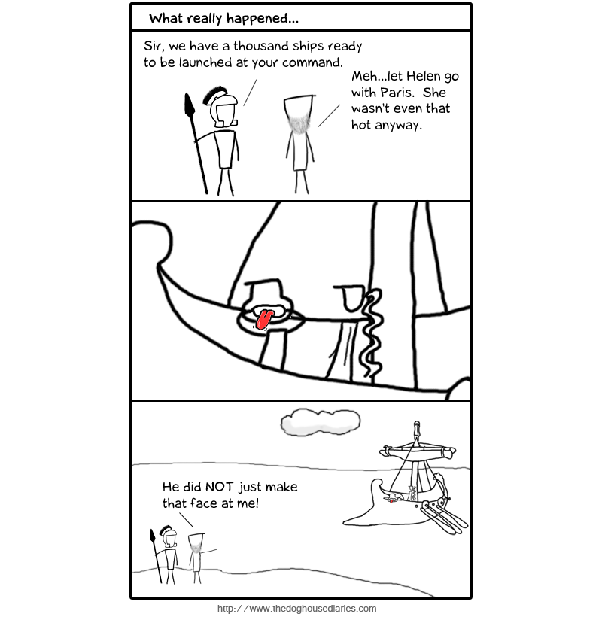
Week 9 Review: Deponent and Irregular Verbs

Slide 2
Deponent Verbs
Deponent Verbs are a class of verbs in Latin that exist in the space between the Active and Passive voices.
In Latin, these deponent verbs will have PASSIVE forms, but ACTIVE meanings and functions.
THE MAIN POINT ABOUT DEPONENTS IS……
They look passive,
but translate active.
(i.e.- They have passive forms, but Active Meanings and Functions)
NB: When identifying deponent verbs for syntax IDs, please identify the VOICE as DEPONENT (not active or passive).
Passive
Deponent
Active

Slide 3
Recognizing Deponent Verbs
Deponents look passive and their principal parts reflect this (i.e., the principal parts have only passive forms)
NB: They have only 3 principal parts!
1st conj.: conor, conārī, conātus sum
2nd conj.: fateor, fatērī, fassus sum
3rd conj.: sequor, sequī, secūtus sum
3rd-io conj.: patior, patī, passus sum
4th conj.: mōlior, mōlīrī, mōlītus sum

Slide 4
Conjugating Deponents
Deponent Verbs conjugate just like the passive forms of regular verbs. So, if you know how to conjugate the passive voice forms for each conjugation, you already know how to form deponents.
Hortor, hortari,
hortatus sum
(Pres. Dep. Ind.)
Hortor
Hortāris (-re)
Hortātur
Hortāmur
Hortāminī
Hortantur
Sequor, sequi,
secutus sum
(Pres. Dep. Ind.)
Sequor
Sequeris (-re)
Sequitur
Sequimur
Sequiminī
Sequuntur
1st sg.
2nd sg.
3rd sg.
1st pl.
2nd pl.
3rd pl.
Note: since deponent Verbs conjugate like passive forms of regular verbs and therefore you know how to conjugate them, just review the passive forms you feel weak on after your previous reviews.

Slide 5
Synopsis of fatēor, fatērī, fassus sum
3rd singular | Active | Passive (Deponent)
Present | --- | Fatētur
Imperfect | --- | Fatēbātur
Future | --- | Fatēbitur
Perfect | --- | fassus, a, um est
Pluperfect | --- | fassus, a, um erat
Future Perf. | --- | fassus, a, um erit
Pres. Subj. | --- | Fateātur
Imperf. Subj. | --- | Fatērētur
Perf. Subj. | --- | fassus, a, um sit
Pluperf. Subj. | --- | fassus, a, um esset
Now, we’ll use a SYNOPSIS to review the various other forms of Deponents. A Synopsis is a chart that shows all the forms of a verb conjugated in a given person and number. Note that for DEPONENT verbs, you will only fill in the PASSIVE forms of a synopsis (with a normal verb you would fill in both columns).
Note: this synopsis is for the 3rd pers. sing.
Review the various forms in this synopsis to remind yourself of the various passive forms of verbs.

Slide 6
Participles
NB: Passive Form, Active Meaning!
Trans: “having lived in the country”
NB: Passive Form, Passive Meaning!
Participles form as expected with deponents.
participle box for: rūsticor, rūsticārī, rūsticātus sum, “to live in the country”
NB: Active Forms, Active Meanings!
 | Active | Passive
Present | rūsticāns | xxxxx
Past (Perf.) | xxxxx | rūsticātus
Future | rūsticāturus | rūsticāndus

Slide 7
Infinitives
For the infinitives of Deponents, there are only 3 types, one for each tense.
In the present and perfect, the forms that we would normally classify as passive function as active, because they are deponent.
In the future, the equivalent active form is used to avoid potential confusion with the passive periphrastic.
For: rūsticor, rūsticārī, rūsticātus sum:
PRESENT: rūsticārī [no pres. act. inf.]
PERFECT: rūsticātus esse [no pf. act. inf.]
FUTURE: rūsticāturus esse [no fut. pass. inf.]

Slide 8
Imperatives
Deponent verbs use the regular present passive imperative forms (translate them as active)
But wait!! There are no present passive imperatives, are there? Yes, but they only exist for the deponent verbs so you might not have seen them yet…
The imperatives of deponents use the form of the 2nd sg./pl. present passive Indicative
(but only the alternate (-re) form in the singular)
Imperatives:
Hortor Fateor Sequor Molior
sg.: Hortare! Fatēre! Sequere! Molire!
pl.: Hortamini! Fatēmini! Sequemini! Molimini!
Note how the singular imperatives look like present active infinitives—there should not be confusion, however, because deponents do not have present active infinitives.

Slide 9
Semi-deponent Verbs
Semi-deponent verbs use normal active endings in the present system, but deponent (passive) endings in the perfect system.
Remember that, like “full” deponents, semi-deponent verbs always have active translations.
What are the principal parts of “audeō”?
audeō, audēre, ausus sum = to dare

Slide 10
Synopsis of audeō, audēre, ausus sum
3rd plural | Active | Passive (Deponent)
Present | Audent | ---
Imperfect | Audēbant | ---
Future | Audēbunt | ---
Perfect | --- | ausī, ae, a sunt
Pluperfect | --- | ausī, ae, a erant
Future Perf. | --- | ausī, ae, a erunt
Pres. Subj. | Audeant | ---
Imperf. Subj. | Audērent | ---
Perf. Subj. | --- | ausī, ae, a sint
Pluperf. Subj. | --- | ausī, ae, a essent
Here’s a SYNOPSIS for the Semi-Deponent audeo. This Synopsis will best show you how semi-deponents work. Note that in the present system, there are only active forms, while the perfect system has only PASSIVE forms.

Slide 11
“PUFFV” Verbs
A special set of 5 deponent verbs take an ablative of means that functions as the direct object.
Potior, potīrī, potītus sum – to possess*
Ūtor, ūtī, ūsus sum – to use**
Fruor, fruī, fructus sum – to enjoy
Fungor, fungī, functus sum – to perform, do
Vescor, vescī, [vescus] – to eat
Ferrō ūtitur = He uses a sword.
(lit. “he benefits himself by means of a sword”)
Nōn audent ūtī nāvibus = They do not dare to use the ships.
What case and why?
“Abl. obj. of utor”
“Abl. of means w/utor”

Slide 12
At last, we can go!
The verb eō, īre, iī, itum (to go) is one of the most common verbs in Latin (as in English)
Generally, it functions as an irregular 4th conjugation verb, with just a few irregularities.
Present stem is ī- but when it is followed by an a, o, or u, it becomes e-
The Future tense forms like 1st or 2nd conjugation
The Perfect stem = i-, which combines with endings that begin -i- = ii-, which contracts to ī- before s.
Passive forms are EXTREMELY rare (except with transitive compounds of eō or when used as an impersonal passive as we have already seen in Caesar).

Slide 13
Practice (all the forms): eo, īre, iī, itum
Pres. Ind. Impf. Ind. Fut. Ind.* Pf. Ind. Plupf. Ind. Fut.Pf. Ind
Eō
Īs
It
Īmus
Ītis
Eunt
Ībam
Ībās
Ībat
Ībāmus
Ībātis
Ībant
Ībō
Ībis
Ībit
Ībimus
Ībitis
ībunt
iī
īstī
iit
iimus
īstis
iērunt
ieram
ierās
ierat
ierāmus
ierātis
ierant
ierō
ieris
ierit
ierimus
ieritis
ierint
Pres. Subj. Impf. Subj.
Pf. Subj. Plupf. Subj.
eam
eās
eat
eāmus
eātis
eant
īrem
īrēs
īret
īrēmus
īrētis
īrent
ierim
ierīs
ierit
ierīmus
ierītis
ierint
īssem
īssēs
īsset
īssēmus
īssētis
īssent
Take special note of the forms outlined in the red boxes; these are the ones where the stem has changed due to the rules given on the previous page.

Slide 14
Other Forms
Imperatives: ī, īte
Participles:
Pres Act: iēns (euntis, euntī, euntem, etc.)
Fut Act: itūrus/a/um
Gerund: eundī, etc.
Infinitives:
Pres. Act.: īre
Fut. Act.: itūrum esse
Perf. Act.: īsse

Slide 15
fero, ferre, tuli, latum
Fero is a very common verb meaning to bear, bring, carry, endure, allow
It is irregular in the PRESENT system ONLY.
The perfect system forms completely as expected (i.e., it is built upon the perfect base tul- according to the usual perfect system rules)
The “irregularities” of fero come from the fact that it is athematic in the present system—meaning that the thematic vowel that usually comes at the end of the stem does not occur.
Be sure to review the present system forms on the following slide (though you will still need to know the perfect system forms, just know that they form regularly)

Slide 16
Fero, ferre, tuli, latum—the present active system to bear, carry, bring, allow, endure
Carefully review the present active system forms of fero.
Be sure to look over the passive forms as well (Bennett #129).
Pr. Ind. Impf. Ind. Fut. Ind. Pres. Subj. Impf. Subj.
Ferō
Fers
Fert
Ferimus
Fertis
Ferunt
Ferēbam
Ferēbās
Ferēbat
Ferēbāmus
Ferēbātis
Ferēbant
Feram
Ferēs
Feret
Ferēmus
Ferētis
Ferent
Feram
Ferās
Ferat
Ferāmus
Ferātis
Ferant
Ferrem
Ferrēs
Ferret
Ferrēmus
Ferrētis
Ferrent
Imperatives:
Fer Ferte

Slide 17
Fio, fieri, factus sum
Fio is a common irregular verb meaning to be done, to occur, to happen
It is used as the passive form for facio in the PRESENT system ONLY.
The perfect forms are identical with the perfect passive forms of facio – so you don’t really need to learn them.
Essentially, it acts something like a reverse-deponent:
active endings / passive meanings

Slide 18
Fio, fieri, factus sum—the present system to occur, happen, become, be done, be made
Pr. Ind. Impf. Ind. Fut. Ind. Pres. Subj. Impf. Subj.
Fīō
Fīs
Fit
Fīmus
Fītis
Fīunt
Fīēbam
Fīēbās
Fīēbat
Fīēbāmus
Fīēbātis
Fīēbant
Fīam
Fīēs
Fīet
Fīēmus
Fīētis
Fīent
Fīam
Fīās
Fīat
Fīāmus
Fīātis
Fīant
Fierem
Fierēs
Fieret
Fierēmus
Fierētis
Fierent
Imperatives:
Fī Fīte

Slide 19
Translating Fio, fieri, factus sum
Translate Fio as a passive of facio
to be made, be done, become, happen, occur
cf: Hoc facit (facio): He does this.
Hoc fit (fio): This is done.
More from fio:
Hoc fiat: Let this be done.
Dicunt hoc fieri: They say that this is done.
Periculum fit gravius: The danger becomes graver.
Fiat lux et lux erat: ???
Think of the Beatles: fiat…
Think of Forrest Gump: Stercus fit.

Slide 20
Volo/Nolo/Malo
Three irregular verbs (volō, nōlō, and mālō) are common enough that you will need to know and be able to recognize the “irregular” forms
volō = to be willing, to want
nōlō = to be unwilling, to not want = (ne/non + volo)
mālō = to prefer = (magis + volo)
All three verbs have only active forms
They are only irregular in the present system
(the perfect system forms regularly)

Slide 21
Indicative: volō, velle, voluī, _____
Indicative | Present | Imperfect | Future
Singular
1st
2nd
3rd
Plural
1st
2nd
3rd
volō
vīs
vult
volumus
vultis
volunt
volēbam
volēbās
volēbat
volēbāmus
volēbātis
volēbant
volam
volēs
volet
volēmus
volētis
volent

Slide 22
Subjunctive: volō, velle, voluī, _____
Subjunctive | Present | Imperfect
Singular
1st
2nd
3rd
Plural
1st
2nd
3rd
velim
velis
velit
velimus
velitis
velint
vellem
velles
vellet
vellemus
velletis
vellent

Slide 23
volō, velle, voluī, _____
Volō, velle has only two infinitives and one participle.
Infinitives: (pres. act.) velle ; (pf. act.) voluisse
Participle: (pres. act.) volēns, volentis
Volō, velle does not have an imperative.

Slide 24
mālō, mālle, māluī, _____
Just review the forms of malo to refamiliarize yourself with them.
 | Present | Imperfect | Future
Singular
1st | mālō | mālēbam | mālam
2nd | māvīs | mālēbās | mālēs
3rd | māvult | mālēbat | mālet
Plural
1st | mālumus | mālēbāmus | mālēmus
2nd | māvultis | mālēbātis | mālētis
3rd | mālunt | mālēbant | mālent

Slide 25
mālō, mālle, māluī, _____
Just review the forms of malo to refamiliarize yourself with them.
Subjunctive | Present | Imperfect
Singular
1st | mālim | māllem
2nd | mālis | mālles
3rd | mālit | māllet
Plural
1st | mālimus | māllemus
2nd | mālitis | mālletis
3rd | mālint | māllent

Slide 26
mālō, mālle, māluī, _____
Mālō, mālle has only two infinitives
Infinitive: mālle; māluisse
Mālō, mālle has no imperatives or participles

Slide 27
nōlō, nōlle, nōluī, _____
Just review the forms of nolo to refamiliarize yourself with them.
 | Present | Imperfect | Future
Singular
1st | nōlō | nōlēbam | nōlam
2nd | nōn vīs | nōlēbās | nōlēs
3rd | nōn vult | nōlēbat | nōlet
Plural
1st | nōlumus | nōlēbāmus | nōlēmus
2nd | nōn vultis | nōlēbātis | nōlētis
3rd | nōlunt | nōlēbant | nōlent

Slide 28
nōlō, nōlle, nōluī, _____
Just review the forms of nolo to refamiliarize yourself with them.
Subjunctive | Present | Imperfect
Singular
1st | nōlim | nōllem
2nd | nōlis | nōlles
3rd | nōlit | nōllet
Plural
1st | nōlimus | nōllemus
2nd | nōlitis | nōlletis
3rd | nōlint | nōllent

Slide 29
nōlō, nōlle, nōluī, _____
Nōlō, nōlle has only two infinitives and one participle.
Infinitive: (pres. act.) nōlle; (pf. act.) nōluisse
Participle: (pres. act.) nōlēns, nōlentis
Nolō, nolle does have imperatives:
Singular: nōlī
Plural: nōlīte

Slide 30
Noli, Nolite: Another Use
The words nōlī and nōlīte are used not only as imperatives of nōlō but also as negative commands of all verbs.
When nōlī and nōlīte are used with present infinitives, they express negative commands.
Nōlīte ex prōvinciā discēdere!
Don’t leave the province!
Nōlī mihi dicere!
Don’t speak to me!

Slide 31
Comparison: present indicative forms
Comparing the present indicative active forms of volo, nolo, and malo can help you realize just how related these three verbs are.
Volō
Vīs
Vult
Volumus
Vultis
Volunt
Nōlō
Nōn vīs
Nōn vult
Nōlumus
Nōn Vultis
Nōlunt
Mālō
Māvīs
Māvult
Mālumus
Māvultis
Mālunt

