Slide 1
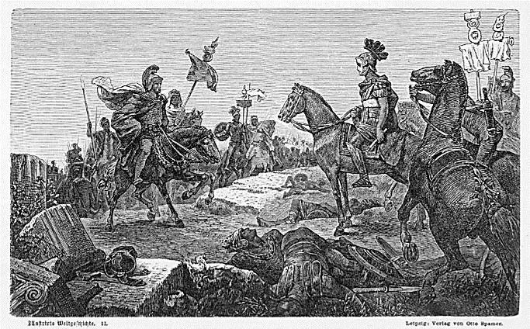
Learning from the Adversary:
The Great Enemy Figures of Greece and Rome
CC 348 / AHC 325

Slide 2
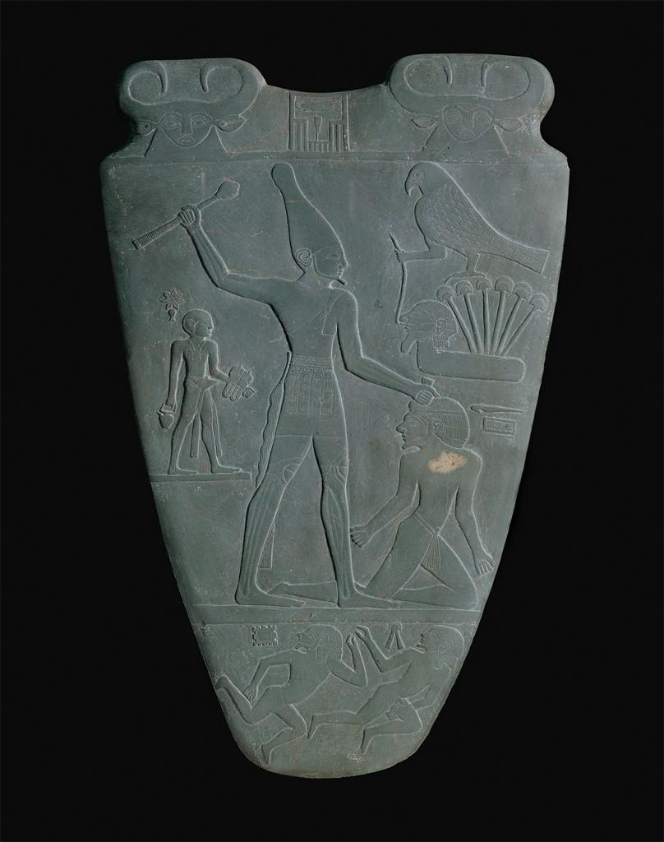
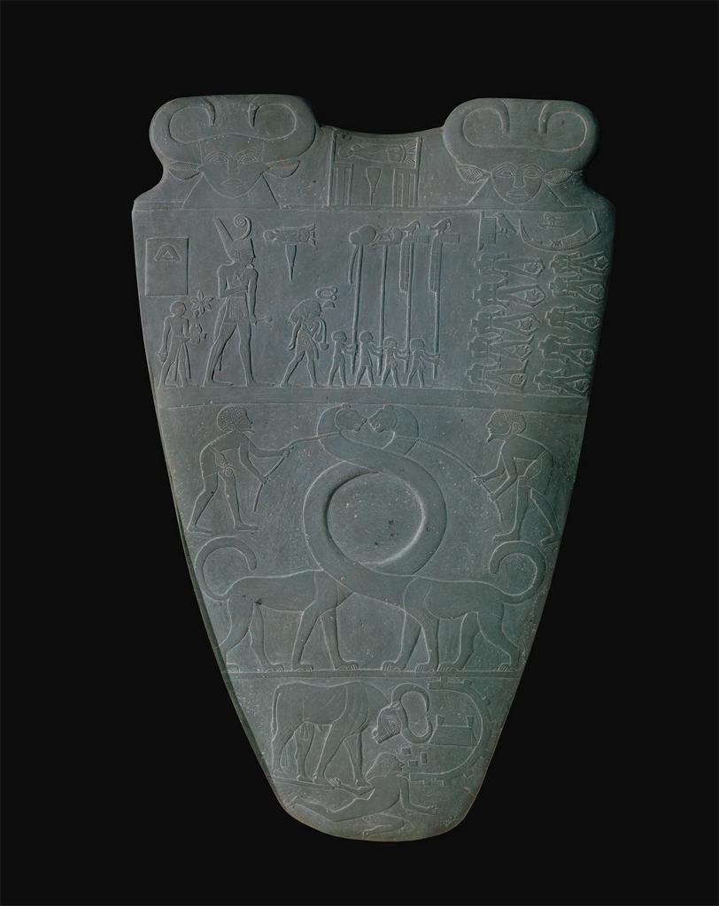
Narmer Palette, Egypt, ca. 3000 BCE

Slide 3
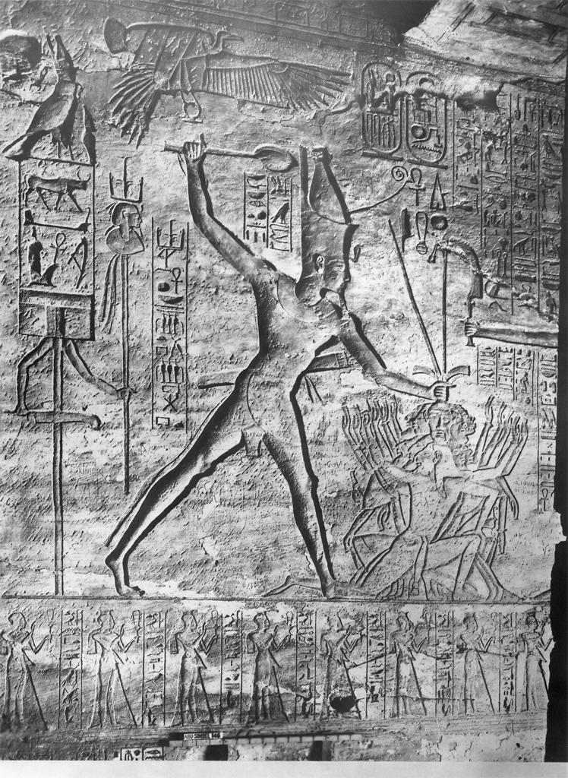
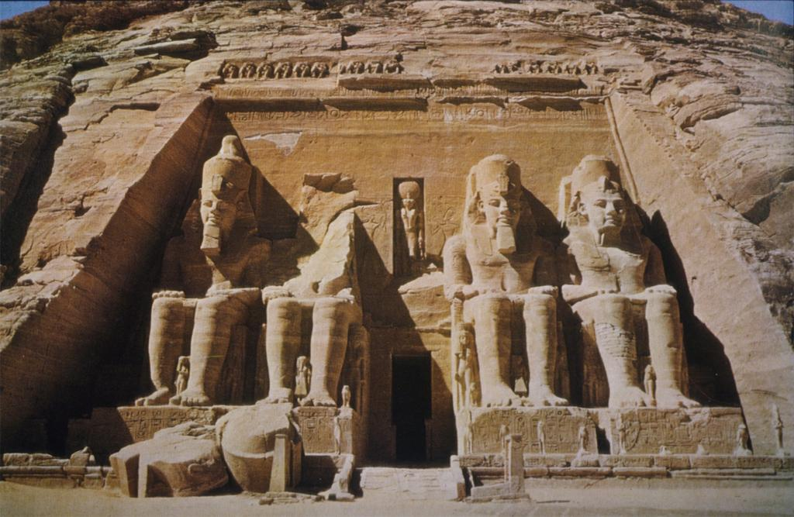
Ramses II Relief, Abu Simbel, Egypt, mid 13th Cent. BCE

Slide 4
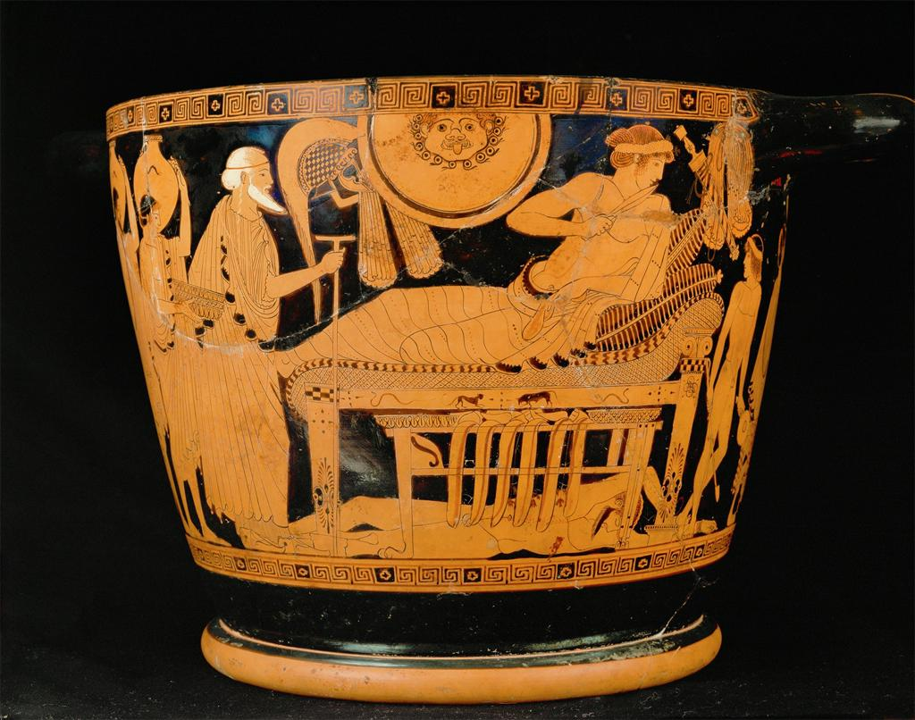
Brygos Painter, Skyphos with Achilles and Priam, Cerveteri, Italy, early Fifth Cent. BCE

Slide 5
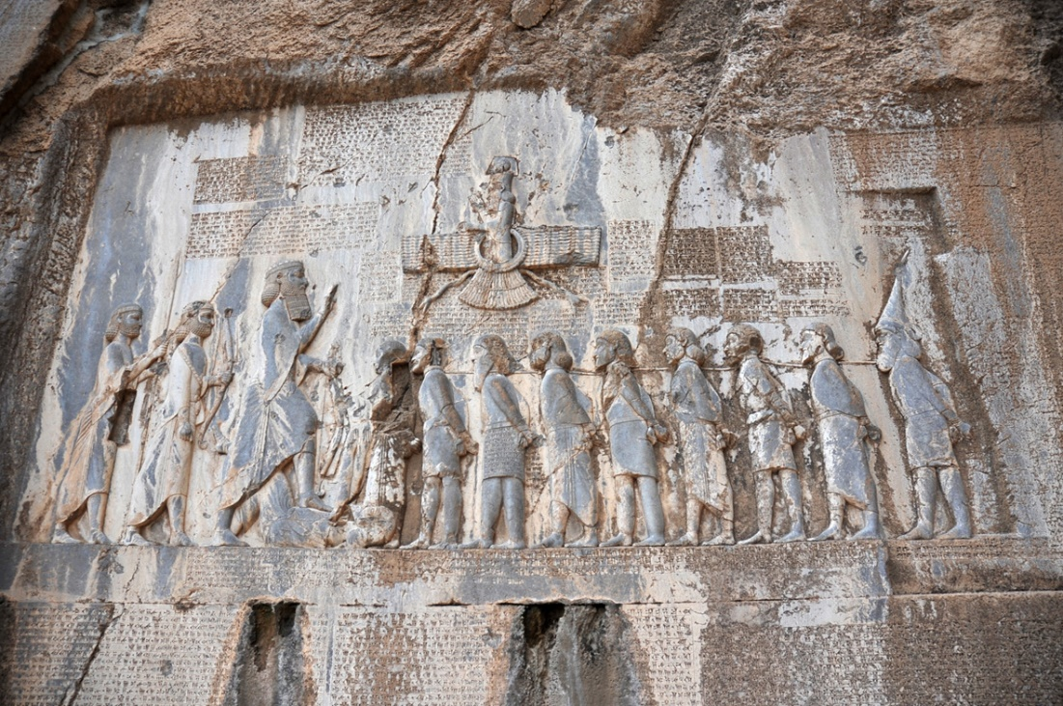
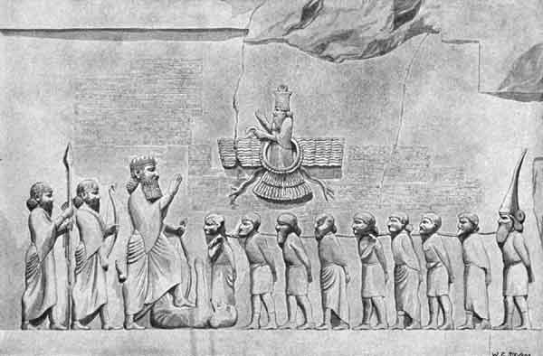
Behistun Inscription, Darius I, Mt. Behistun, Iran, early Fifth Cent. BCE

Slide 6
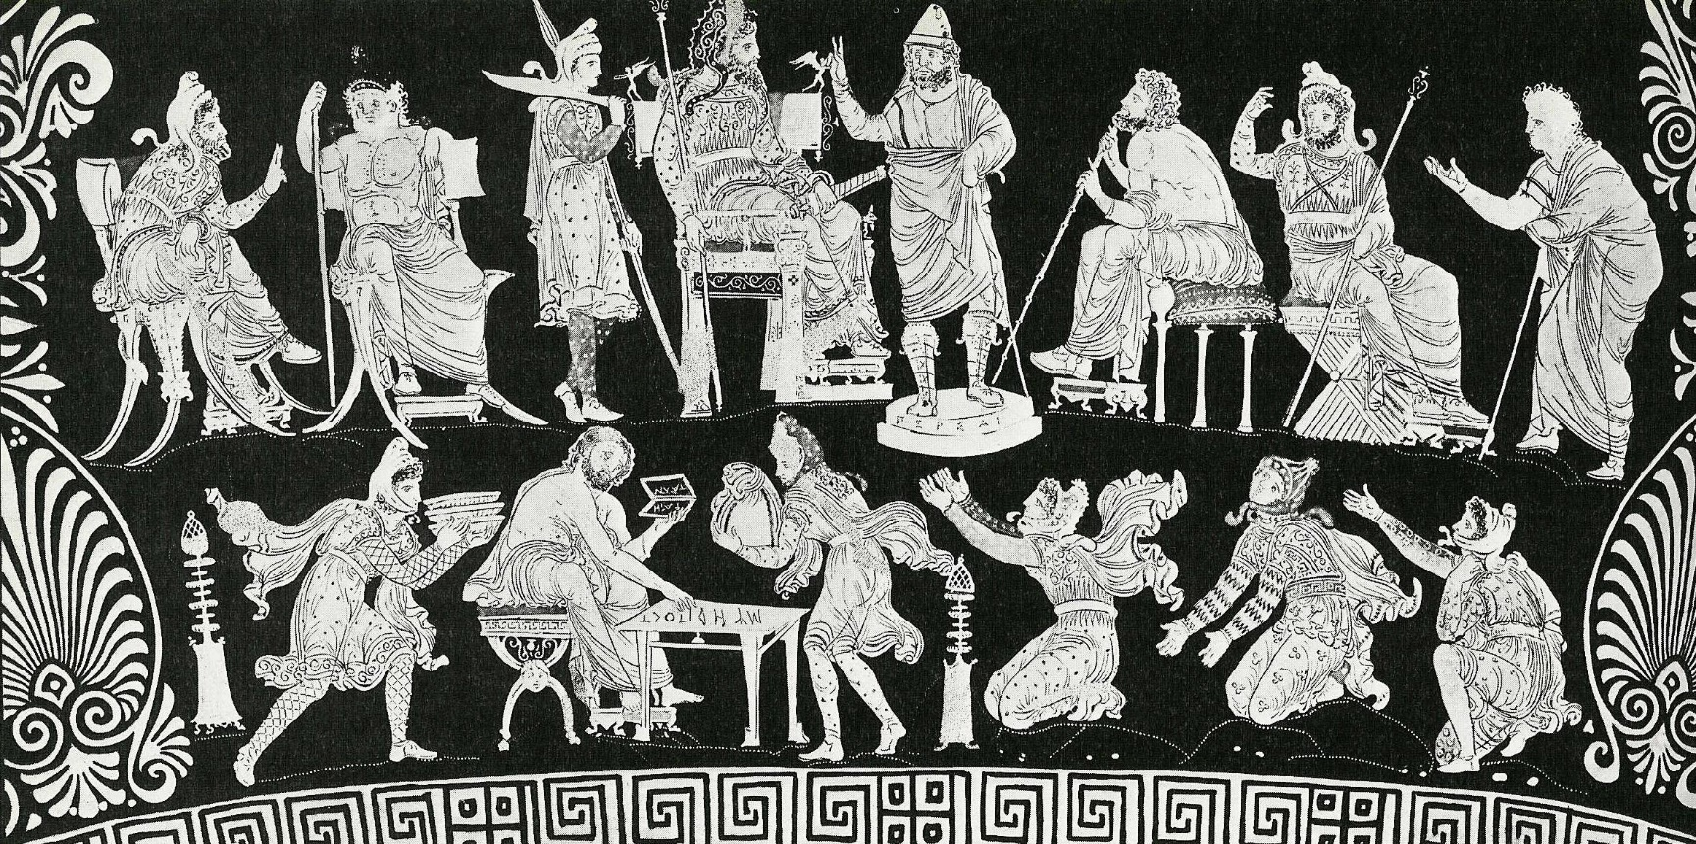
Darius Vase, Darius Painter, Apulia, Italy, ca. 340-20 BCE

Slide 7
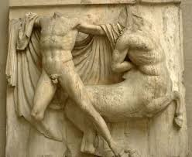
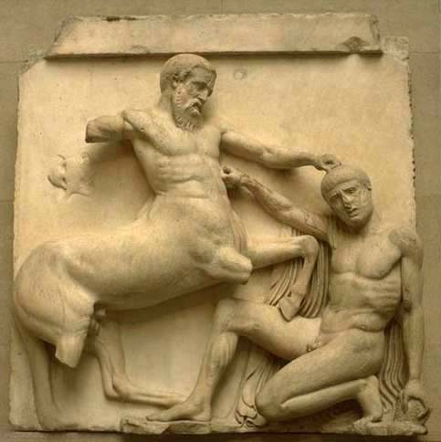
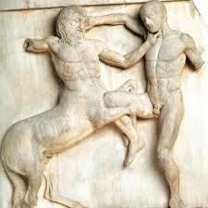
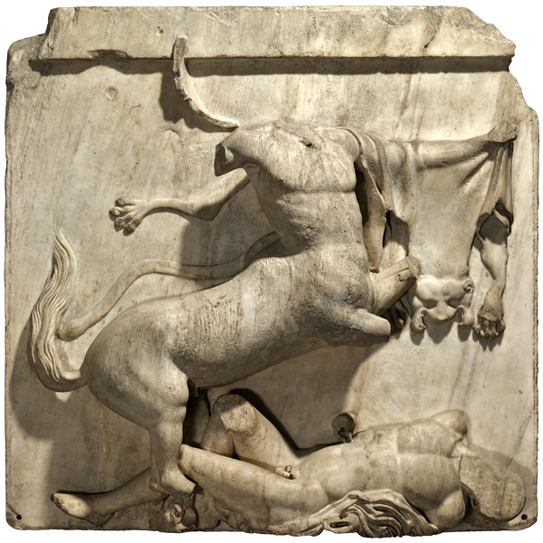
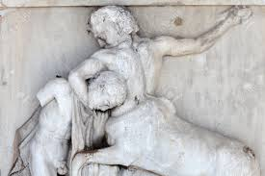
Parthenon Frieze, Phidias, Athens, Greece, south metope, ca. 447-438 BCE

Slide 8
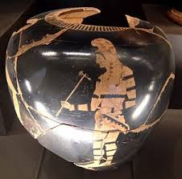
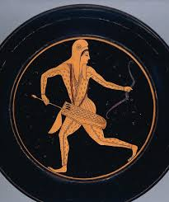
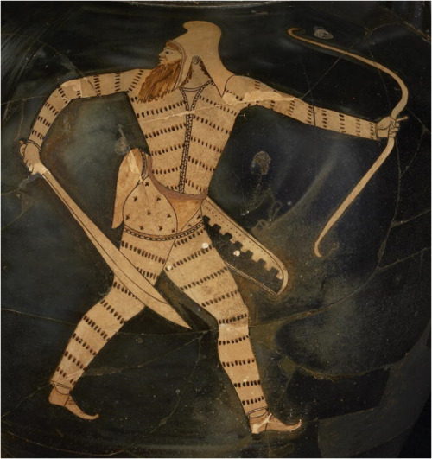
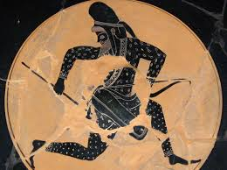
Various Scythians on Red- and Black-Figure Vases, Greece and So. Italy, 6-4th Cent. BCE

Slide 9
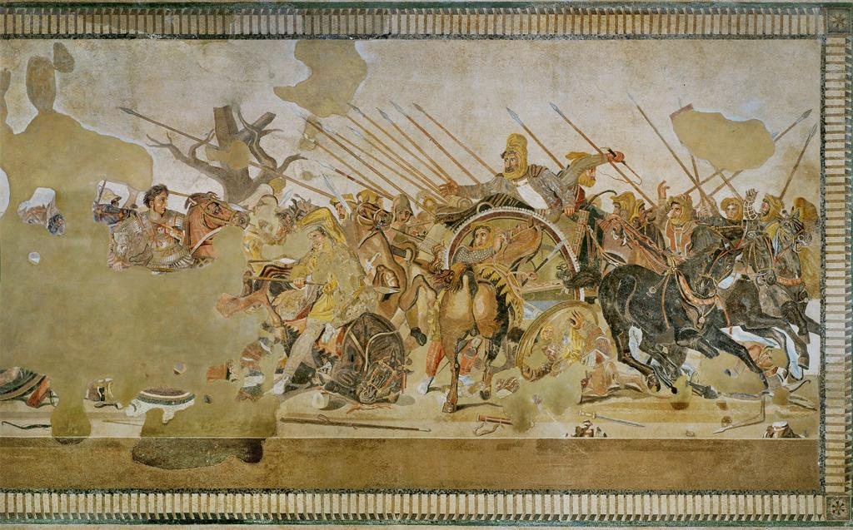
Alexander Mosaic, House of the Faun, Pompeii, Italy, 1st Cent. CE copy of Greek painting from 3rd Cent. BCE

Slide 10
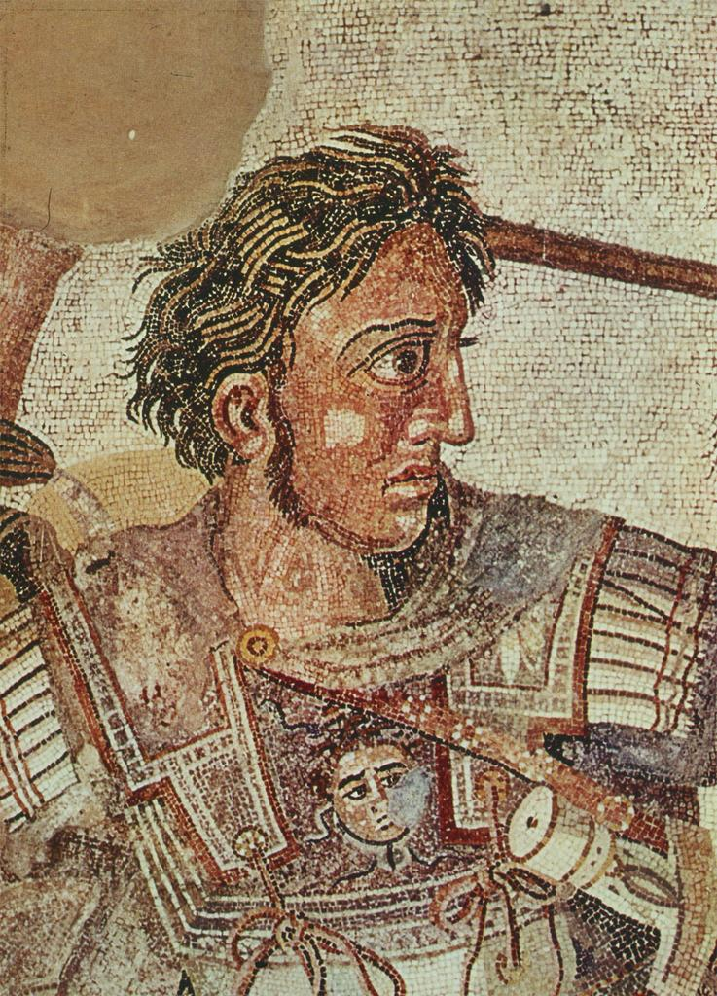
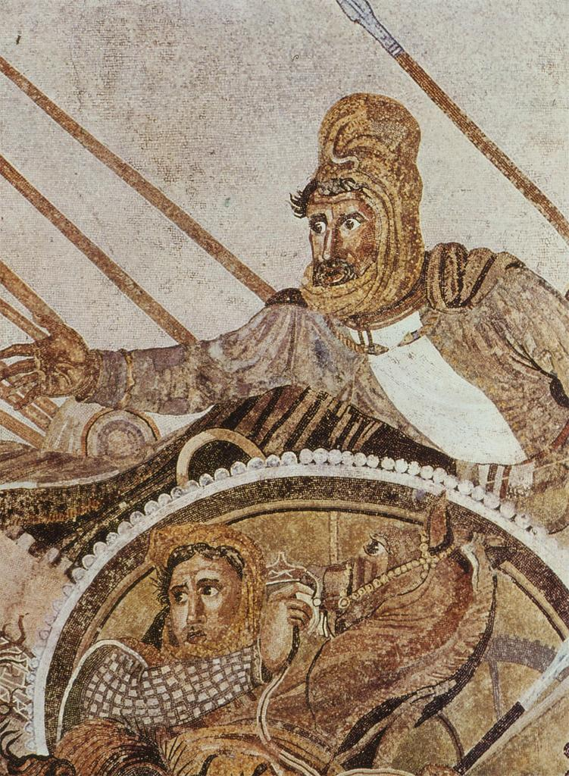
Alexander Mosaic, House of the Faun, Pompeii, Italy, 1st Cent. CE copy of Greek painting from 3rd Cent. BCE

Slide 11
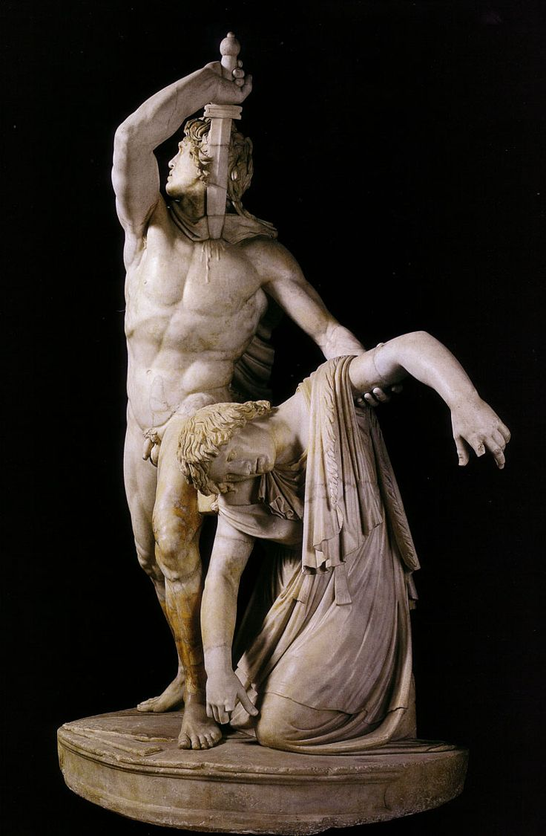
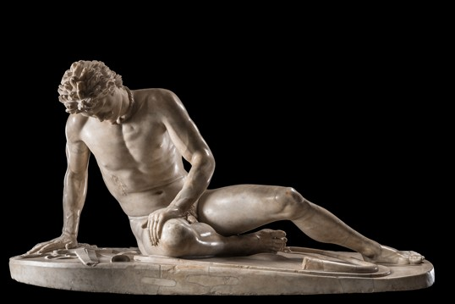
“Dying Gaul” and “Ludovisi Gaul” (“Gaul Killing himself and Wife”), Roman marble copy (mid 2nd cent. BCE) of bronze original for Attalus I, Pergamum, Turkey, ca. 220 BCE

Slide 12
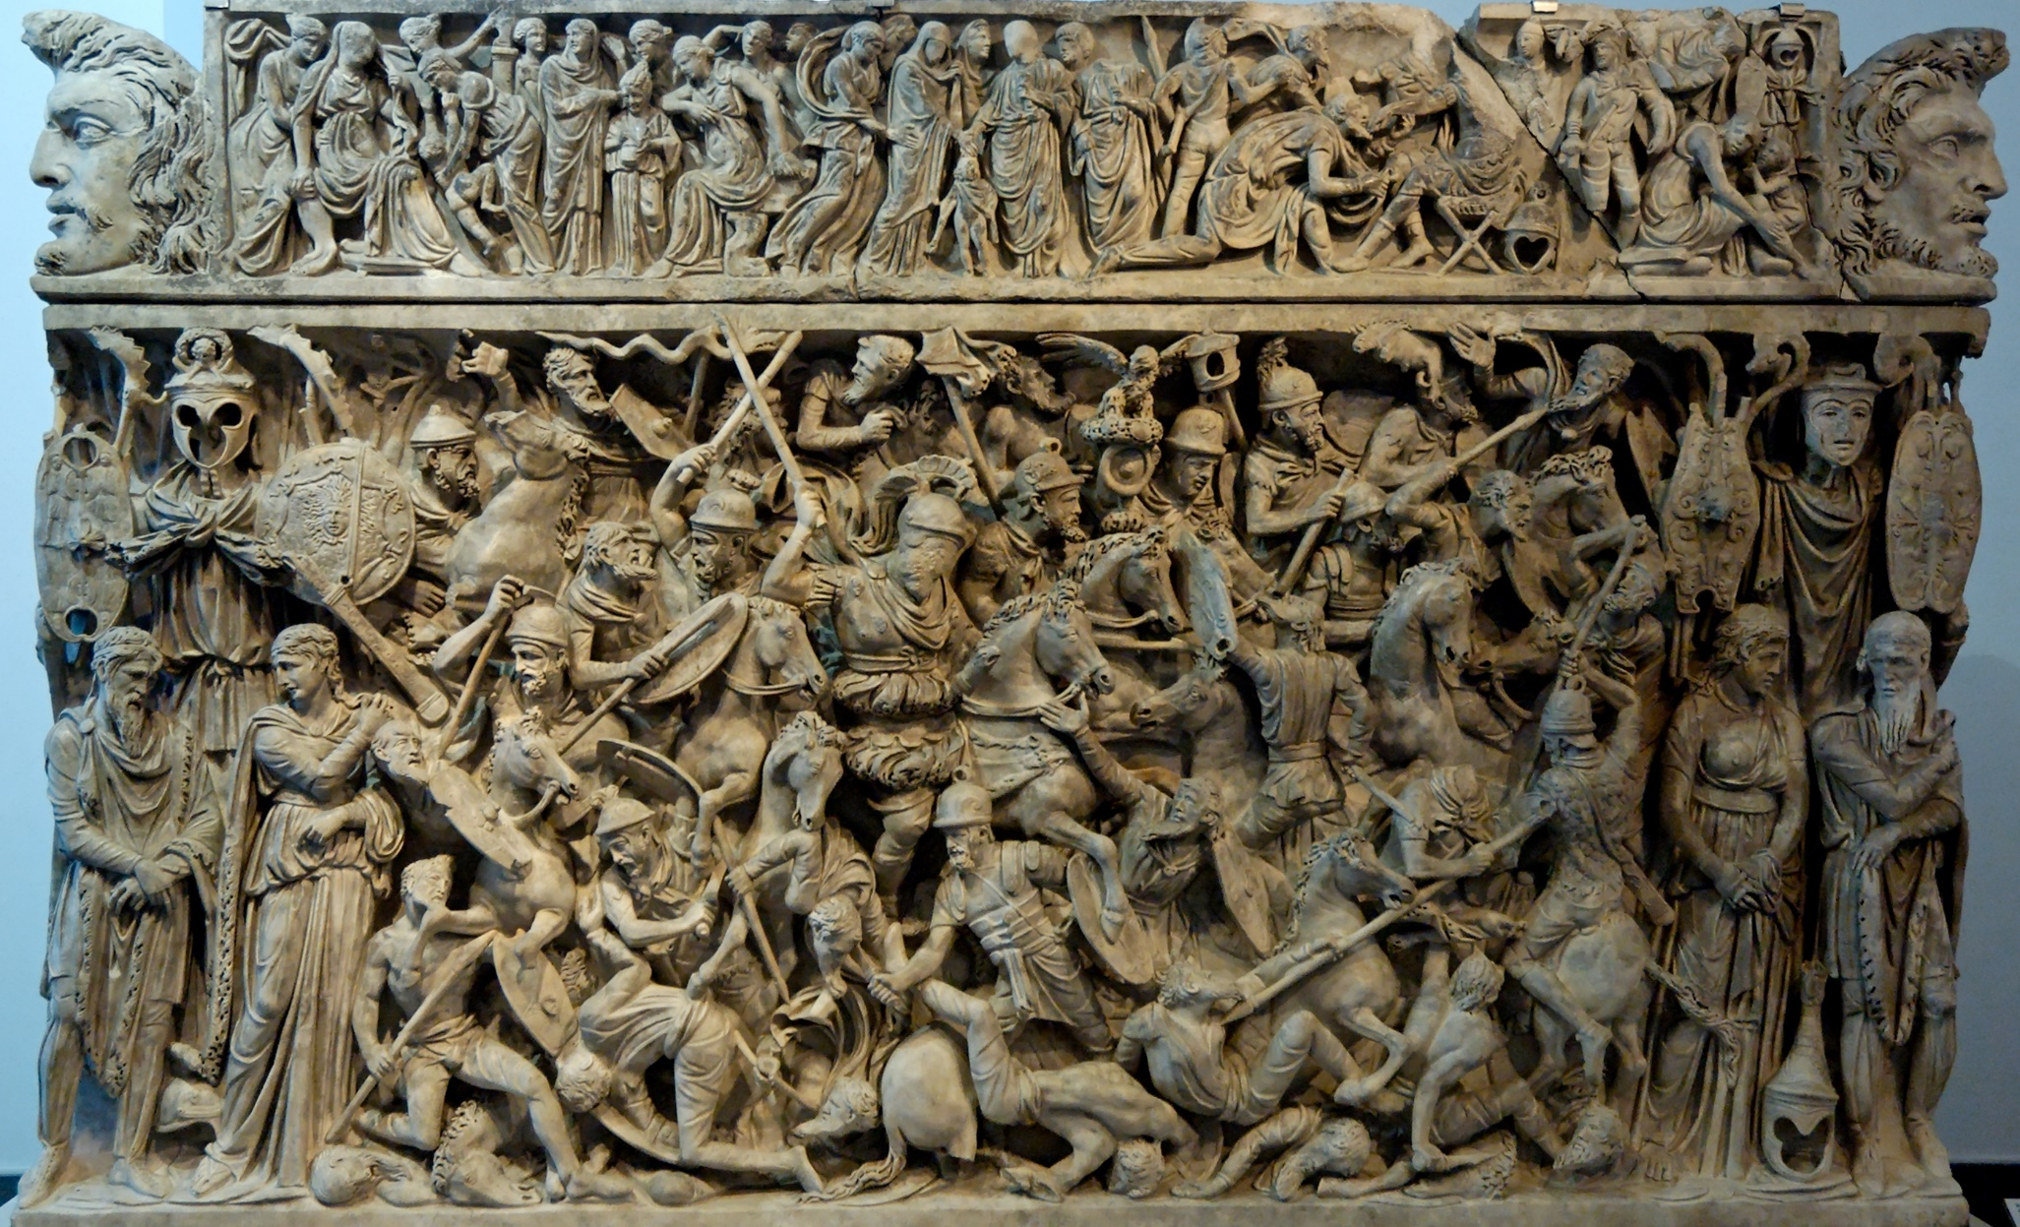
Portonaccio Sarcophagus, Rome, ca. 190 CE

Slide 13
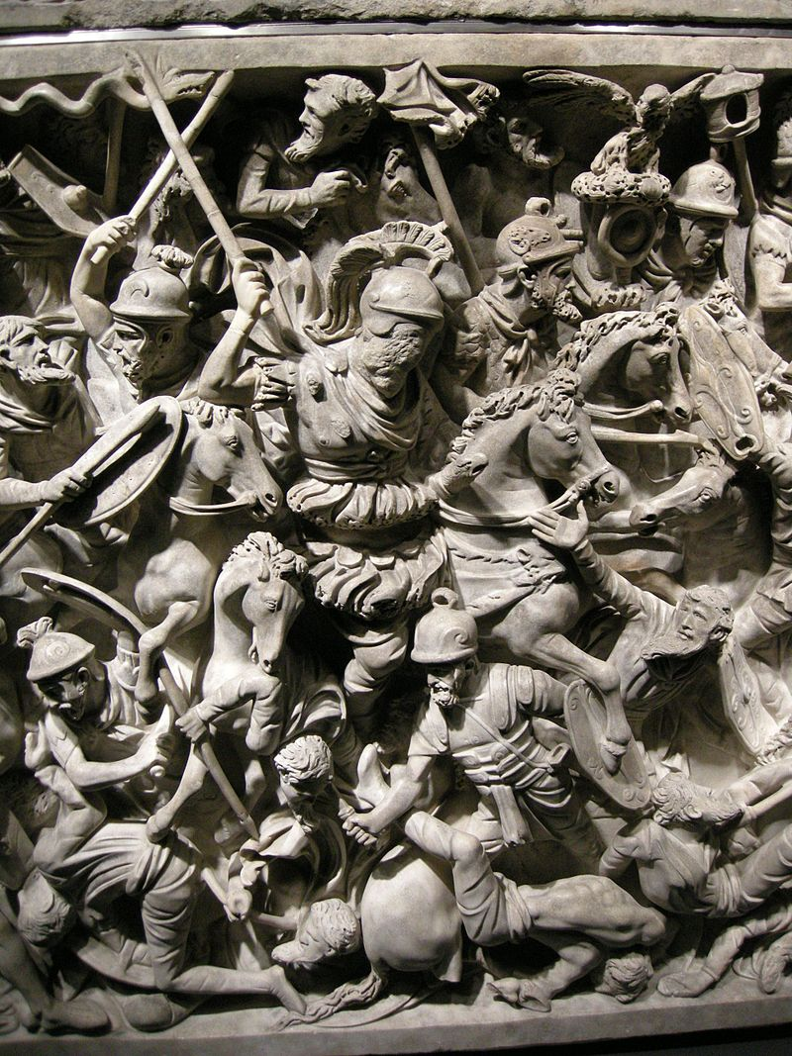
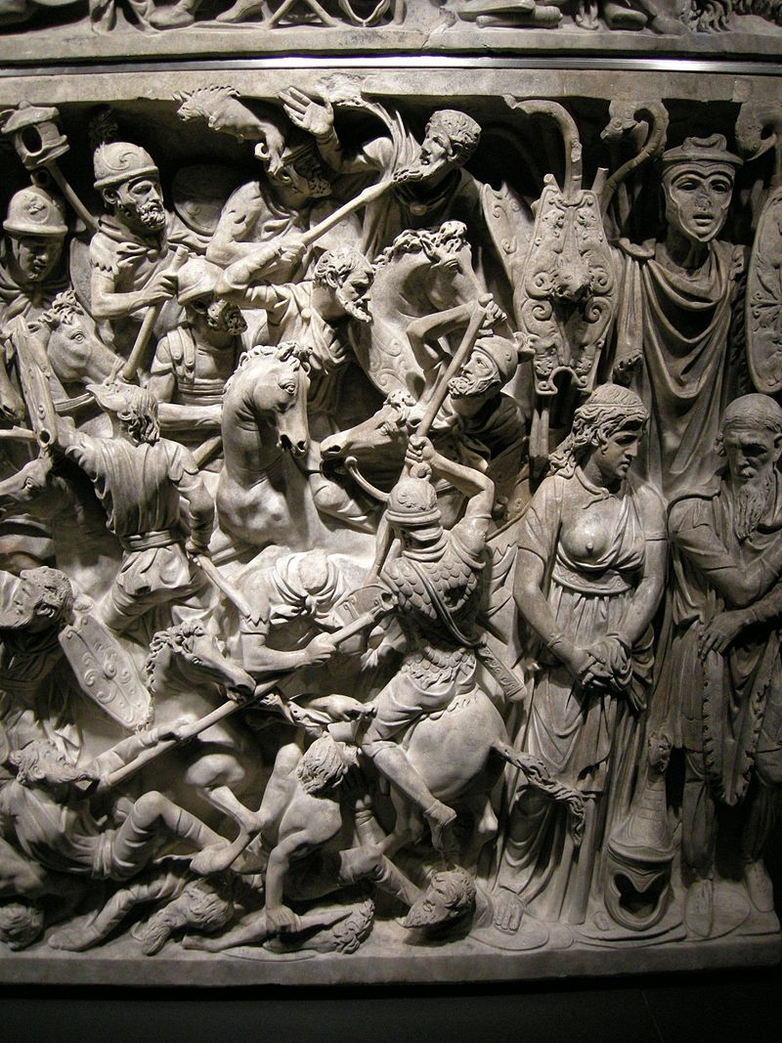
Portonaccio Sarcophagus, Rome, ca. 190 CE

Slide 14
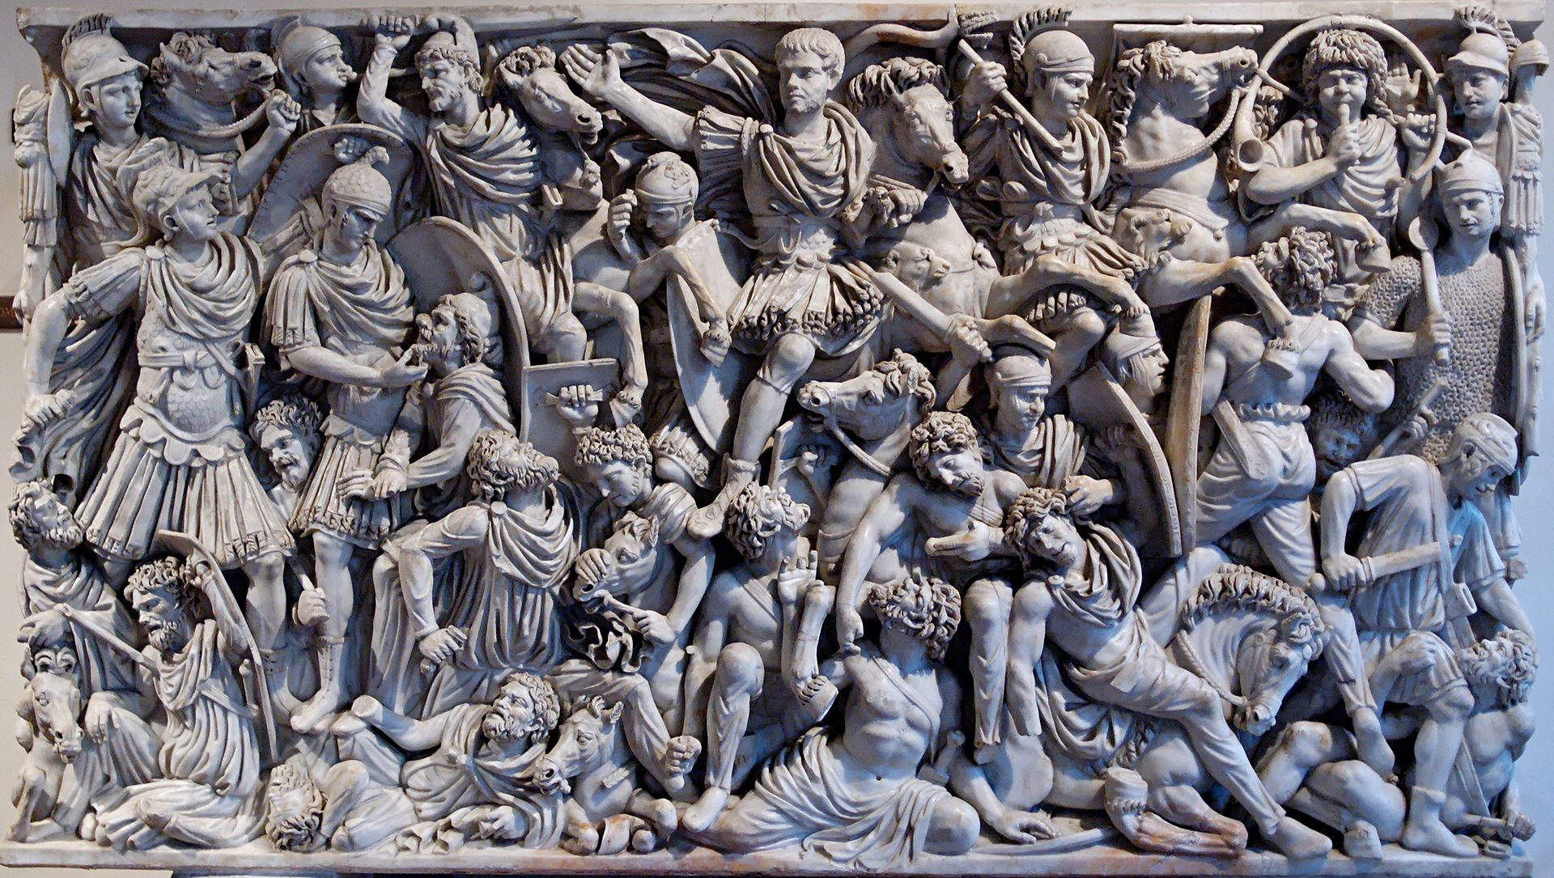
Ludovisi Sarcophagus, Rome, ca. 250 CE

Slide 15
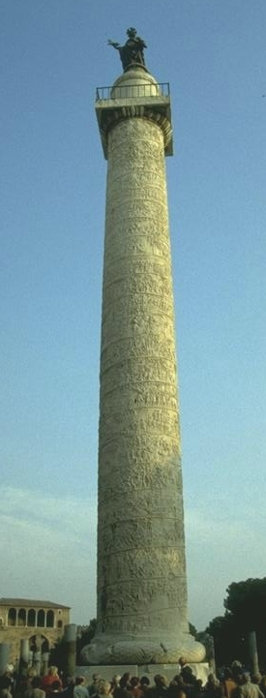
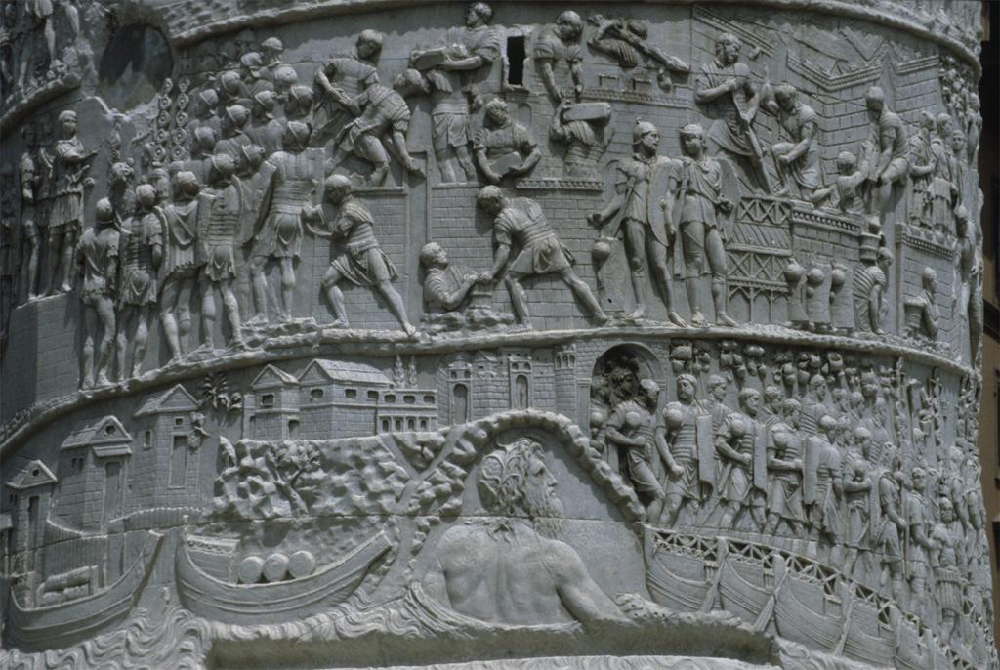
Trajan’s Column, Rome, 113 CE
Romans set out on Campaign

Slide 16
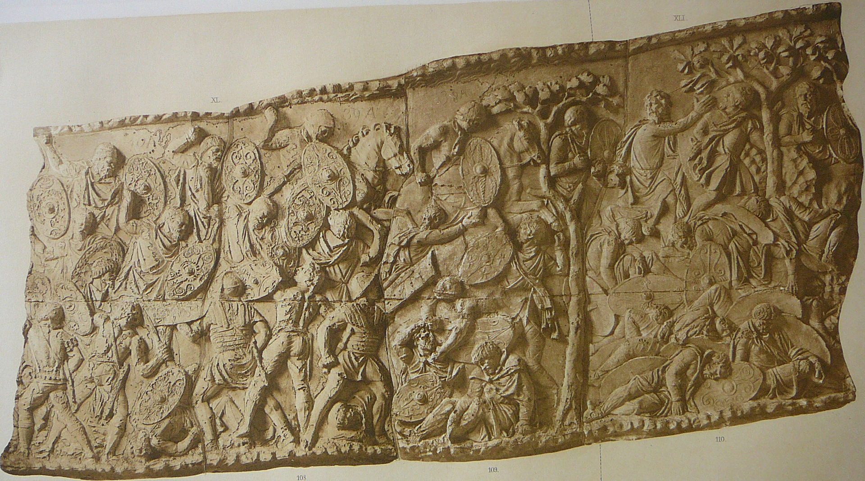
Trajan’s Column, Rome, 113 CE
Dacians and Romans Battle

Slide 17
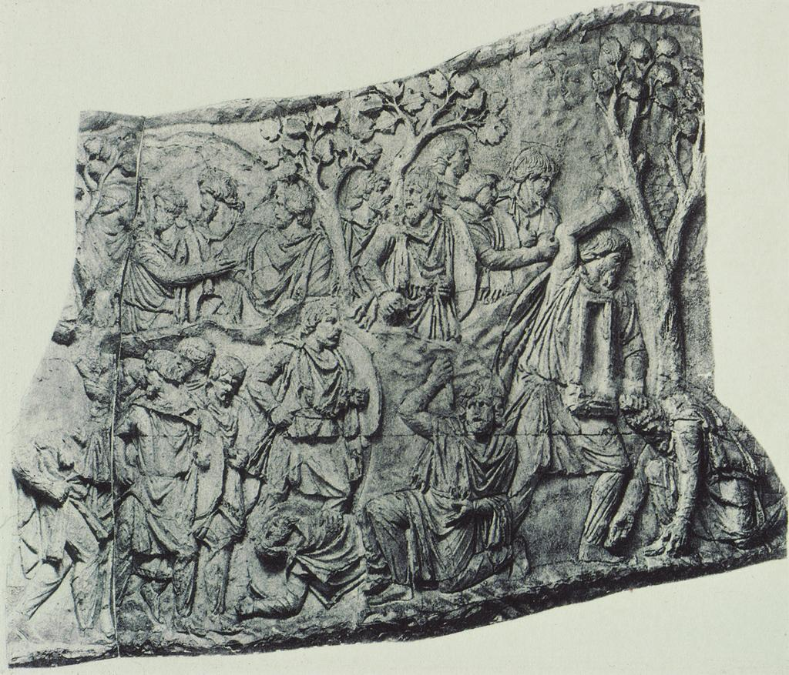
Trajan’s Column, Rome, 113 CE
Dacians killing themselves and each other

Slide 18
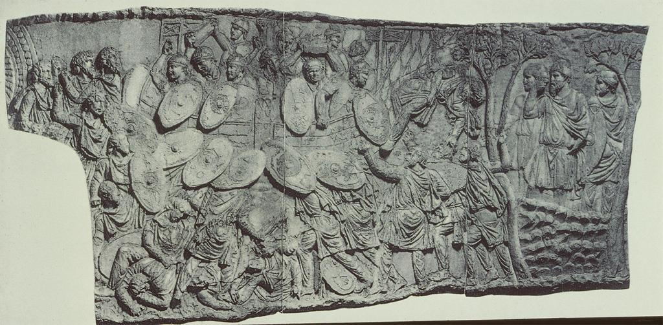
Trajan’s Column, Rome, 113 CE
Dacians attack Roman Camp, Decebalus watching on the right

Slide 19
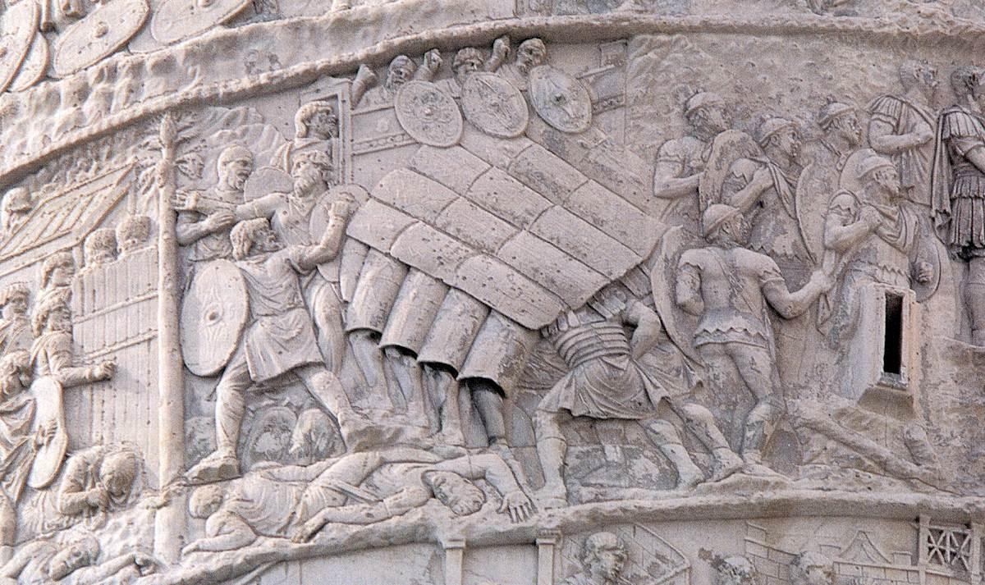
Trajan’s Column, Rome, 113 CE
Romans attack Dacian Fortress

Slide 20
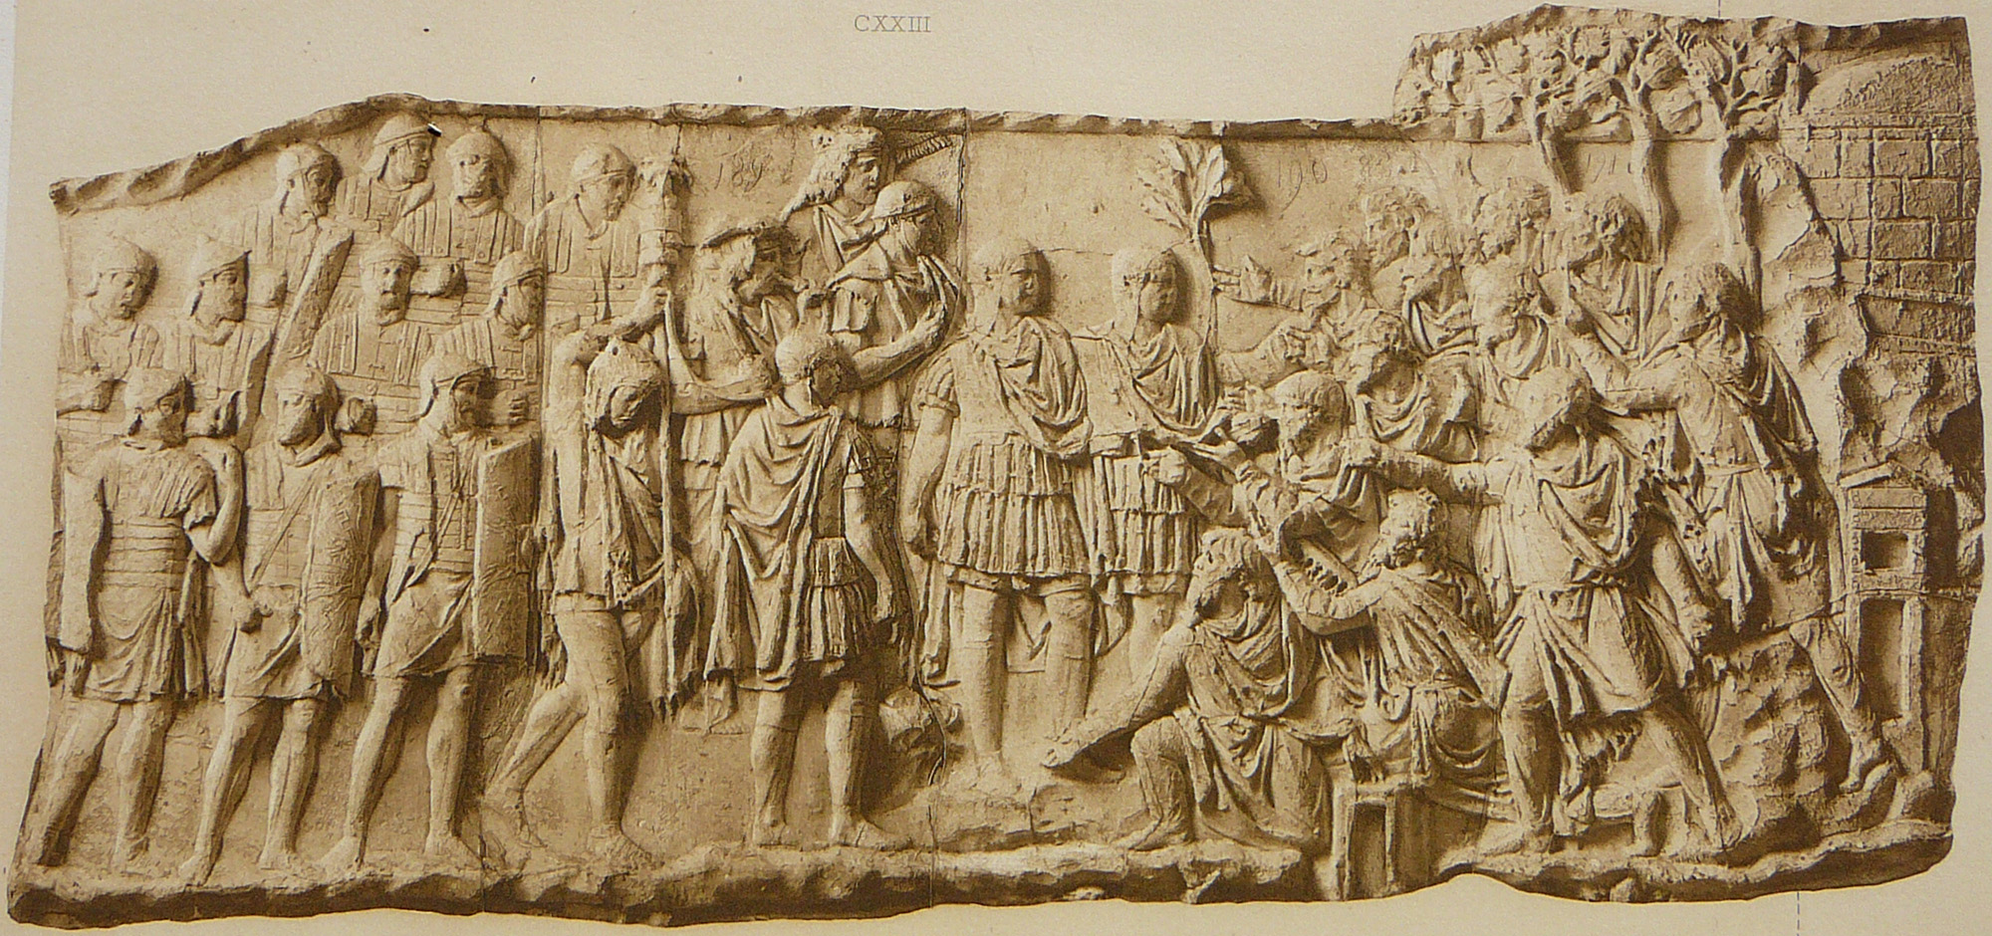
Trajan’s Column, Rome, 113 CE
Dacians Surrender to Trajan

Slide 21
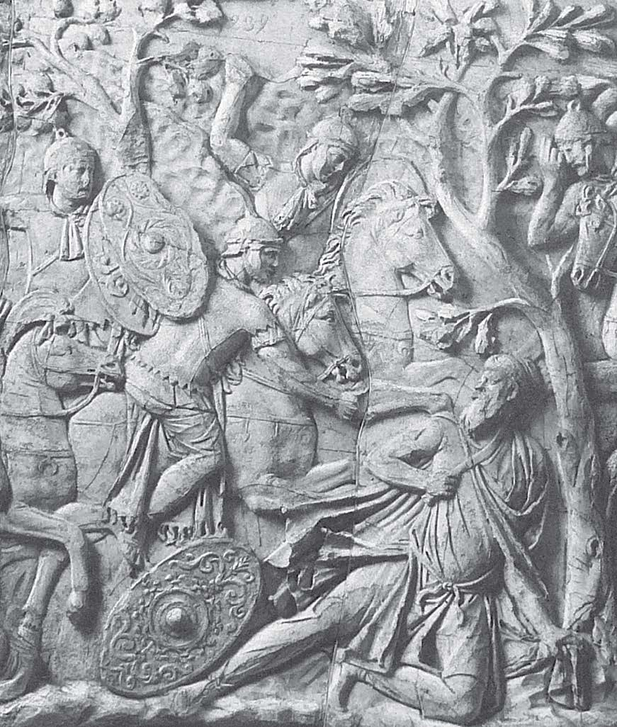
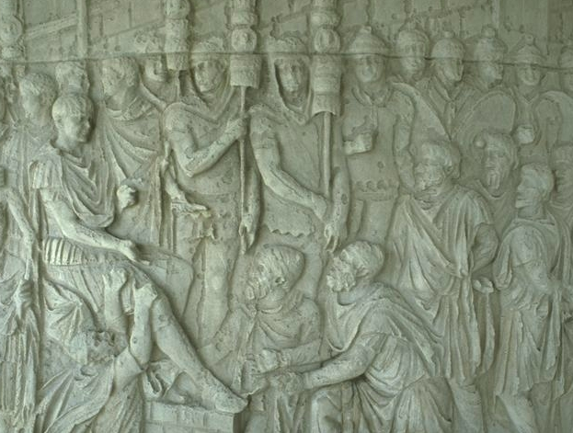
Trajan’s Column, Rome, 113 CE
Death of Decebalus Trajan Accepts Surrender

